Slide 1

A Data Mining approach on the analysis of Road Safety in Great Britain
Vignesh Muthumani (10385771)
M.Sc. in Data Analytics, Dublin Business School
Supervisor: Dr. Shahram Azizi Sazi

Slide 2
Contents
1
Research Problem
2
Introduction
3
Literature review
4
Methodology
5
Implementation
6
Conclusion
7
References

Slide 3
Contents
1
Research Problem
2
Introduction
3
Literature review
4
Methodology
5
Implementation
6
Conclusion
7
References

Slide 4
Research Problem
“How can the occurrences of road traffic accidents of high severity on Great Britain roads be reduced using classification modelling techniques (Decision Trees, Random Forest, Naïve Bayes, Logistic Regression, Support Vector Machines)?”
“Would chaining the Random Forest technique with another classification algorithm yield better results in prediction?”
Justification: Previous researches show that the predictions were done based on the road and weather conditions and other environment related factors. With data insufficiency, information of casualties and vehicles weren’t considered for prediction of the severity of road traffic accidents. But now that the data has been updated in the data.gov.uk and made available for the public, this research project will also make use of all other potential attributes such as driver information, vehicle information, etc. to determine the severity of road traffic accidents in Great Britain more efficiently.

Slide 5
Research Objectives
To critically review the work accomplished in the area of road traffic accidents in Great Britain and identify the gaps in the literature.
To identify the key principal components that have a major impact on the road traffic accidents.
To demonstrate the ways of handling an imbalanced data
To implement and evaluate the classification models and assess their results to identify the most effective prediction algorithm
To experiment the idea of chaining two algorithms by identifying the significant attributes of the data using Random Forest technique and feeding the significant ones as input to other classification techniques to identify if it yields better results.

Slide 6
Contents
1
Research Problem
2
Introduction
3
Literature review
4
Methodology
5
Implementation
6
Conclusion
7
References

Slide 7
Introduction
Road Traffic Accidents (RTAs) are one of the primary reasons of death in today’s world as it ranks as the 10th leading cause of death globally according to World Health Organization (WHO).
Based on the current trends of road traffic accidents, it further predicts that it could rank up to the 7th spot for leading cause of deaths by 2030 (Jackson & Cracknell, 2018).
The 2030 Agenda for Sustainable Development has set an ambitious target of halving the global number of deaths and injuries from road traffic crashes by 2020, as currently it is estimated that approximately 1.35 million people die due to road traffic accidents every year (data.gov.uk, 2018).
Especially the developing nations account for 93% of world’s fatalities on roads, though these nations have 60% of world’s vehicles. As a result, these road traffic mishaps cost 3% of GDP (Gross Domestic Product) to most of the countries (data.gov.uk, 2018).

Slide 8
Introduction (cont’d.)
According to (Beshah & Hill, 2010), several factors such as the road type, road surface conditions, weather conditions, light conditions, time of the day, etc. contribute a lot to determine the severity of road accidents.
By analyzing these factors and making effective predictions using data mining techniques, proper precautional measures can be taken in minimizing the severity of these road traffic accidents significantly.

Slide 9
Contents
1
Research Problem
2
Introduction
3
Literature review
4
Methodology
5
Implementation
6
Conclusion
7
References

Slide 10
Literature review
Several studies by (Kabeer, 2016), (Atnafu & Kaur, 2017) have been carried out to identify the factors that influence these road accidents and steps to reduce its occurrences and lower its severity.
Factors related to road and environment like road separation, road orientation, road surface, weather conditions, light conditions (Beshah & Hill, 2010) have a major role in the severity of the road traffic accidents.
Road system’s defects and its impacts: Defects in the road system is one of the key factors that can’t be ignored as it results in road traffic accidents. According to (Esmaeili, et al., 2012), there are various defects in the road system such as insufficient road width, traffic signs, road surface, slope of the road, road curves, and road lighting could lead to road traffic accidents.

Slide 11
Literature review (cont’d.)
Factors considered while modelling road traffic accidents: Road traffic accidents involves vehicles along with the presence of some other factors such as road, environment, vehicle or driver-related terms (Theofilatos, et al., 2012), (Ghomi, et al., 2017), (Yannis, et al., 2005) that have major influence in the road traffic accidents. According to (Vorko-Jovic, et al., 2006), to have effective road accident prevention, it is necessary to find the most likely factors that contribute in the road accidents.
Earlier due to insufficient data, research was done only using road and environment related factors like road surface, orientation, urban or rural area, speed limit, light condition and weather conditions (Beshah & Hill, 2010), (Mahajan & Kaur, 2016). The use of different factors like human, vehicle, road and environment-related have been taken into consideration by (Zhang, et al., 2013) to improvise the prediction model.

Slide 12
Literature review (cont’d.)
Supervised classification algorithms: Classification process consist of two stages, building the model and prediction of the future data (Patel & Mistry, 2015). The model building stage makes use of any classification algorithm while the prediction stage makes use of the future data to provide patterns.
Decision tree: Decision tree uses top-down recursive approach to perform the classification (Ahlawat & Suri, 2016). The author (Mahajan & Kaur, 2016) has explained two main concepts entropy and information gain and have used them in the ID3 and C4.5 algorithms. Entropy is randomness used to find homogeneity in the data while information gain is the splitting method used in entropy. (Atnafu & Kaur, 2017) has used the advanced version of ID3 decision tree i.e. J48 which determines the target value based on the attribute value.

Slide 13
Literature review (cont’d.)
Supervised classification algorithms:
Random Forest: used for both classification and regression models (Patel, 2010). It is an enhancement over decision tree model. This model consists of forest of trees where the input is assigned to each tree in the forest and the output generated from the forest of trees determine the accuracy of the algorithm. As per (Datla, 2015), increase in the variable results in stronger forest and decrease in the variable results in poor forest for classification. According to (Li, et al., 2017) performance of random forest is more than decision tree, naive bayes and adaboostM1 classifier.
Logistic Regression: a popularly used statistical model that is mainly used for supervised classification techniques. It was devised by David Cox in 1958 (Zekić-Sušac, et al., 2016). The model functions by predicting the dependent variable/target variable that’s a binary variable with two outcomes based on several independent variables that can either be numeric or categorical with classes.

Slide 14
Literature review (cont’d.)
Supervised classification algorithms:
Support Vector Machines: used for both classification analysis and regression analysis. It functions by plotting all the datapoints in a multi-dimensional space. The number of dimensions for this space is determined by the number of attributes the dataset has. Then it involves in finding the hyper-plane between the plotted data points in the multi-dimensional area that separates two major classes on either side of the planes. The hyper plane that distinguishes the classes is termed as the support vector machine while the coordinates of it are termed as support vectors (Huang, 2017). Depending on the type of dataset, different kernels can be implemented for better efficiency of the model in finding the effective hyper plane. Kernels such as linear, radial, polynomial, etc. can be used to identify the perfect the hyper plane that gives the best accuracy.

Slide 15
Literature review (cont’d.)
Supervised classification algorithms:
Naïve Bayes: an effective classification algorithm widely used in road accident dataset (Atnafu & Kaur, 2017). It uses Bayesian theorem to predict the class probabilities. Classification and prediction of the variable is done on the assumption of independence between the variables. Bayesian theorem works, based on belief and former experience. The following tables shows the comparison of reviews of different classification algorithms used in road traffic accidents by different authors.
Author | Model | Accuracy (%)
(Datla, 2015) | Random Forest | 81.34
(Beshah & Hill, 2010) | KNN | 80.81
(Kabeer, 2016) | Bayesian Boosting | 78.03
(Tavakoli Kashani, et al., 2011) | CART | 51.27
(Tesema, et al., 2005) | Decision Tree | 79.83

Slide 16
Literature review (cont’d.)
Due to increase in road traffic accidents different researches have been carried out to lower the number of casualties. (Atnafu & Kaur, 2017) has proposed a model to lower the number of road accidents in India using data mining techniques. Author (Vorko-Jovic, et al., 2006) has determined different risk factors that have serious effect on road transport to lower the road accidents in urban area. Violation of traffic rules and the risk associated with it is briefly explained by (Zhang, et al., 2013).
Even though many researches have been done regarding the road traffic accidents, but very few authors have considered the factors like driver and vehicle-related to build the model. If these gaps are taken into consideration, the model will provide more influential results to lower the road traffic accidents.

Slide 17
Contents
1
Research Problem
2
Introduction
3
Literature review
4
Methodology
5
Implementation
6
Conclusion
7
References

Slide 18
Methodology
The candidate has adopted Cross-industry Standard Process for Data Mining (CRISP-DM) throughout the research project. Based on the polls of the KDNuggets, CRISP-DM is one of the popular methodologies that comes with six different phases.

Slide 19
Process flow

Slide 20
Contents
1
Research Problem
2
Introduction
3
Literature review
4
Methodology
5
Implementation
6
Conclusion
7
References

Slide 21
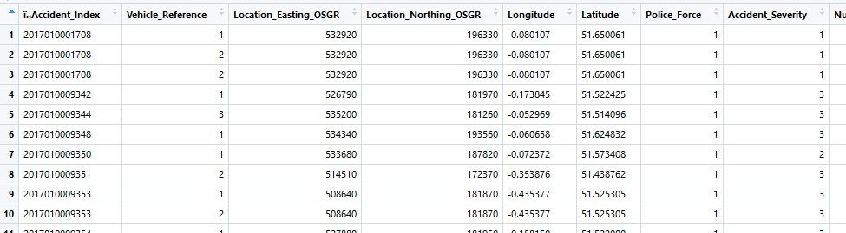
Implementation
This section comprises of data understanding and preparation, data modelling and data evaluation.
Data Preparation: The initial data preparation involves collating the dataset, as the repository consists of three files ‘accident.csv’, ‘casualty.csv’ and ‘vehicle.csv’. These three files are loaded into the RStudio and merged together into one csv file based on their respective ‘accident index’ using the ‘merge’ function of R programming.

Slide 22

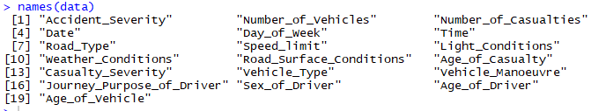
Data Preparation (cont’d.)
Treating missing values
Selecting the attributes

Slide 23
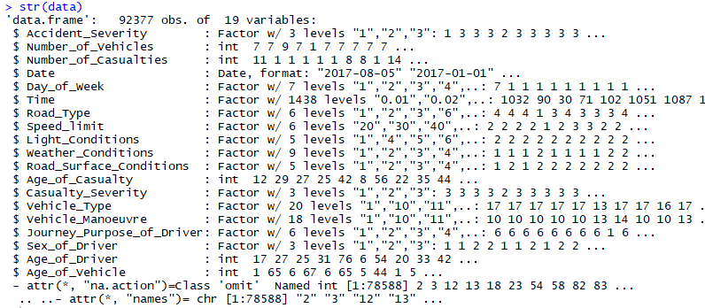
Data Preparation (cont’d.)
Treating the class of variables

Slide 24
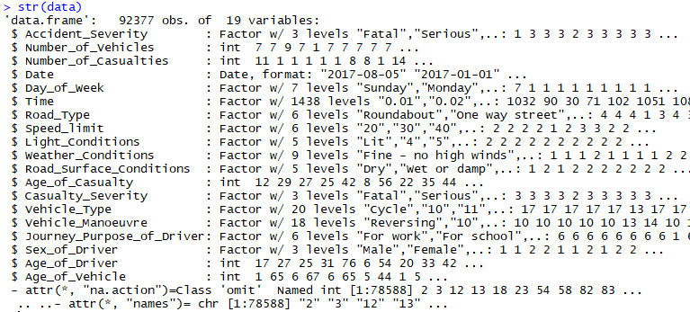
Data Preparation (cont’d.)
Renaming the levels of factors for better understanding

Slide 25
Data Preparation (cont’d.)
Binning factor variables: Binning the levels in a factor variable involves in combining several levels into one for better data analysis and increasing the uniqueness of each level. The following levels of the variables are binned accordingly for an effective analysis,
The ‘time’ variable consists of timestamps of the accident occurrence. In order to make this more meaningful and useful, the variable is converted into a factor variable containing 4 levels: ‘Morning (5-12)’, ‘Afternoon (12-17)’, ‘Evening (17-20)’, and ‘Night (20-5)’.
The ‘light conditions’ with 5 levels were shrunk to 3 levels: ‘Lit’, ‘Dark’, ‘Unknown’.
The ‘weather conditions’ with 9 levels were reduced to 8 levels: ‘Fine – no high winds’, ‘Rain – no high winds’, ‘Snow – no high winds’, ‘Fine – high winds’, ‘Rain – high winds’, ‘Snow – high winds’, ‘Fog/Mist’, ‘Other’.
The ‘Vehicle type’ with 20 levels were way harder to interpret. Hence, they were reduced to 6 broad categories: ‘Cycle’, ‘Motorcycle’, ‘Car’, ‘Bus/Coach’, ‘Tram’, ‘Other’.

Slide 26
Data Preparation (cont’d.)
The ‘Vehicle Manoeuvre’ with 18 levels were reduced to just 4 meaningful levels: ‘Reversing’, ‘Parked’, ‘Taking turn’, ‘Overtaking’.
The variable, ‘Journey purpose of driver’ with 7 levels were reduced to 3 levels: ‘For work’, ‘For school’, ‘Other’.
The variable, ‘Road surface conditions’ was categorized into 7 levels: ‘Dry’, ‘Wet/Damp’, ‘Snow’, ‘Frost/Ice’, ‘Flood (3cm. deep)’, ‘Oil/Diesel’, ‘Mud’.
The variable, ‘Day of the week’ was simply classified into ‘Monday’, ‘Tuesday’, ‘Wednesday’, ‘Thursday’, ‘Friday’, ‘Saturday’, and ‘Sunday’.
The variable, ‘Road type’ was classified into ‘Roundabout’, ‘One way street’, ‘Dual carriageway’, ‘Single carriageway’, ‘Slip road’, ‘Unknown’.
The target variable, ‘Accident Severity’ consists of 3 levels: ‘Fatal’, ‘Severe’, ‘Slight’. However, the data is imbalanced as shown in (figure 10), as a result, the target variable is biased towards the class ‘Slight’ with 80% of data. Hence, the two levels ‘fatal’ and ‘severe’ are combined into one level as ‘High’, while the other majority class as ‘Low’.

Slide 27
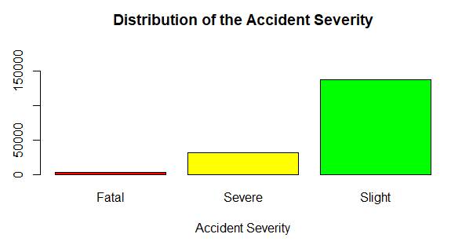
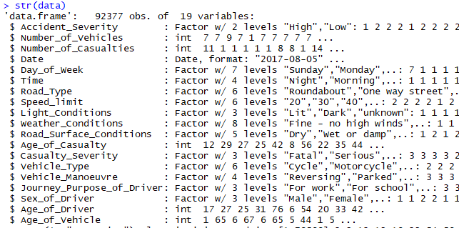
Data Preparation (cont’d.)

Slide 28
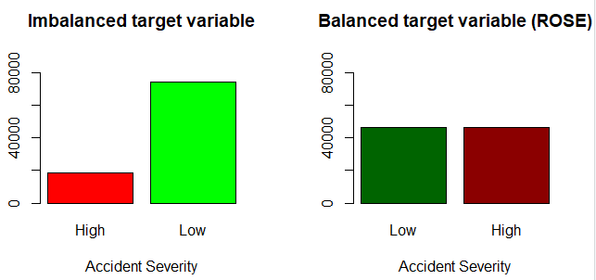


Data Preparation (cont’d.)
Handling imbalanced data

Slide 29
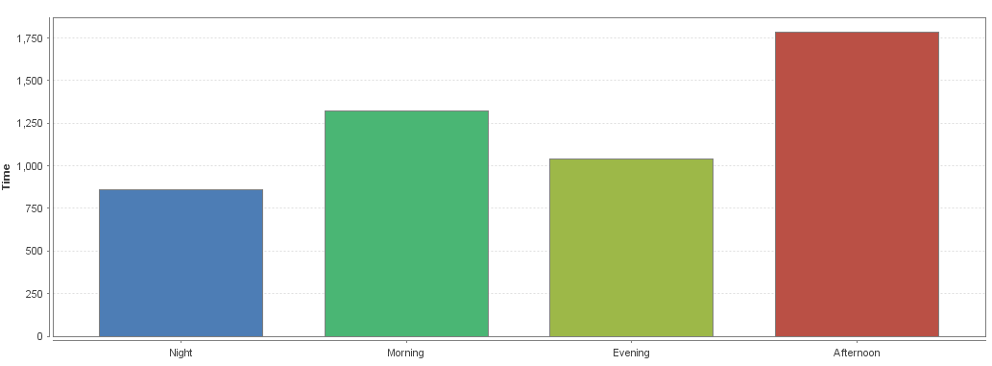
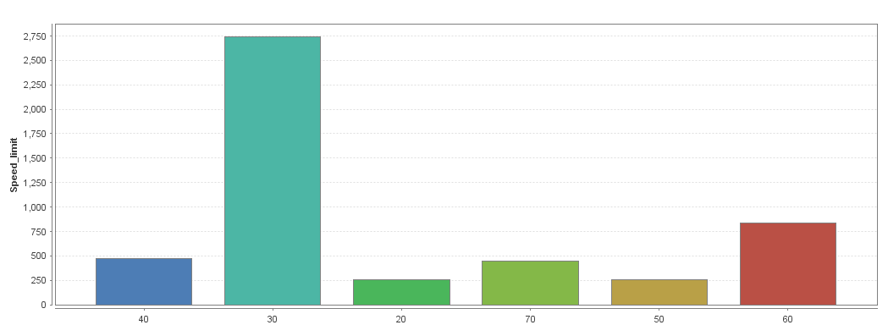
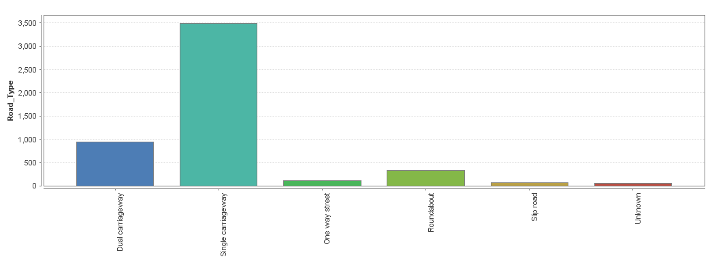
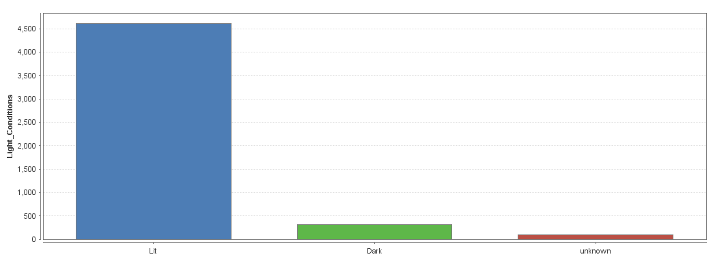
Data Preparation (cont’d.)

Slide 30
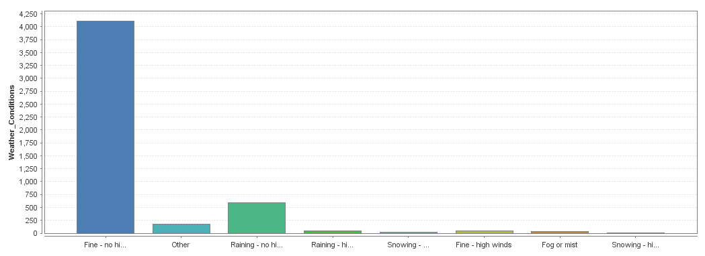
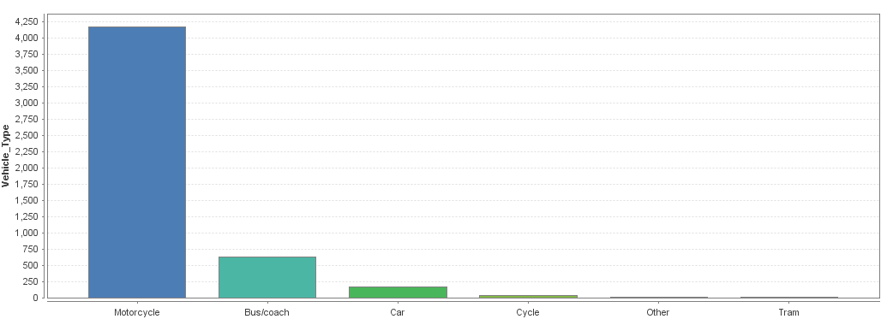
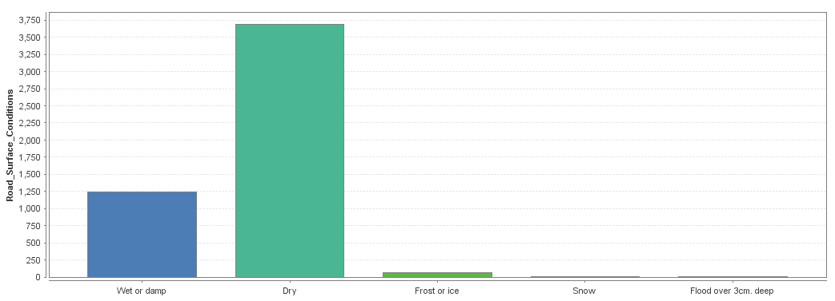
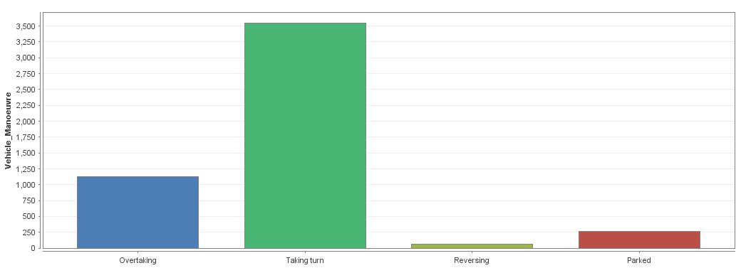
Data Preparation (cont’d.)

Slide 31
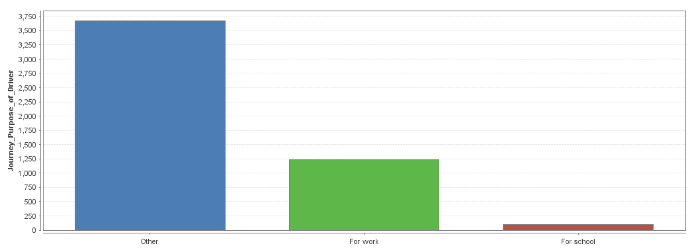
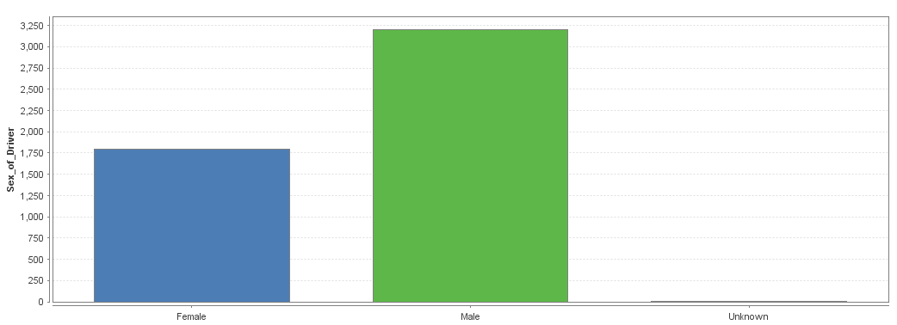
Data Preparation (cont’d.)

Slide 32

Data Preparation (cont’d.)
Removal of the variable ‘casualty severity’:

Slide 33
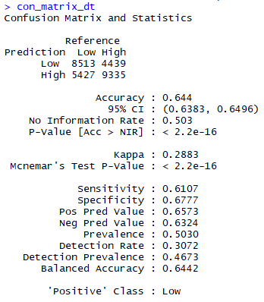
Data modelling: Decision tree

Slide 34
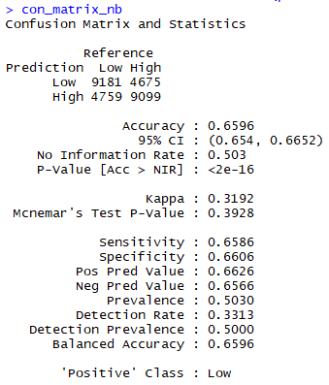
Data modelling: Naïve Bayes

Slide 35
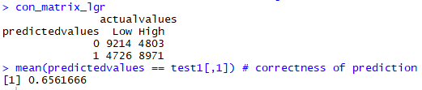
Data modelling: Logistic Regression

Slide 36
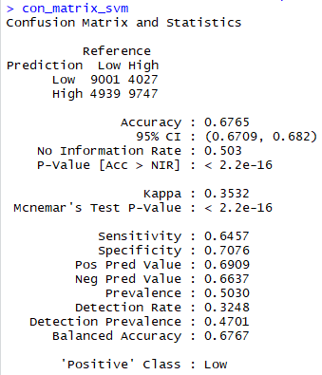
Data modelling: Support Vector Machines

Slide 37
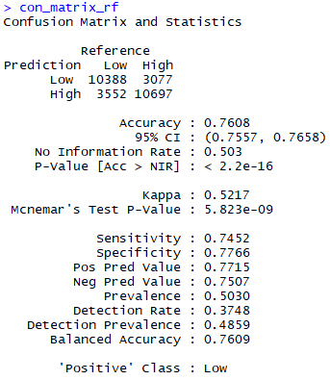
Data modelling: Random Forest

Slide 38
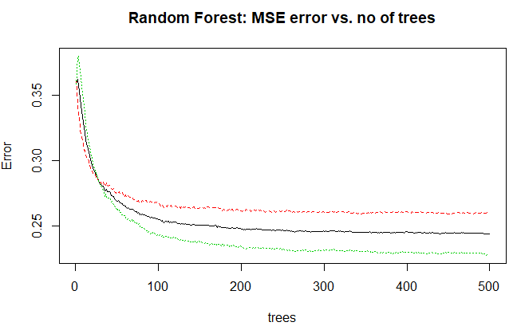
Data modelling: Random Forest

Slide 39
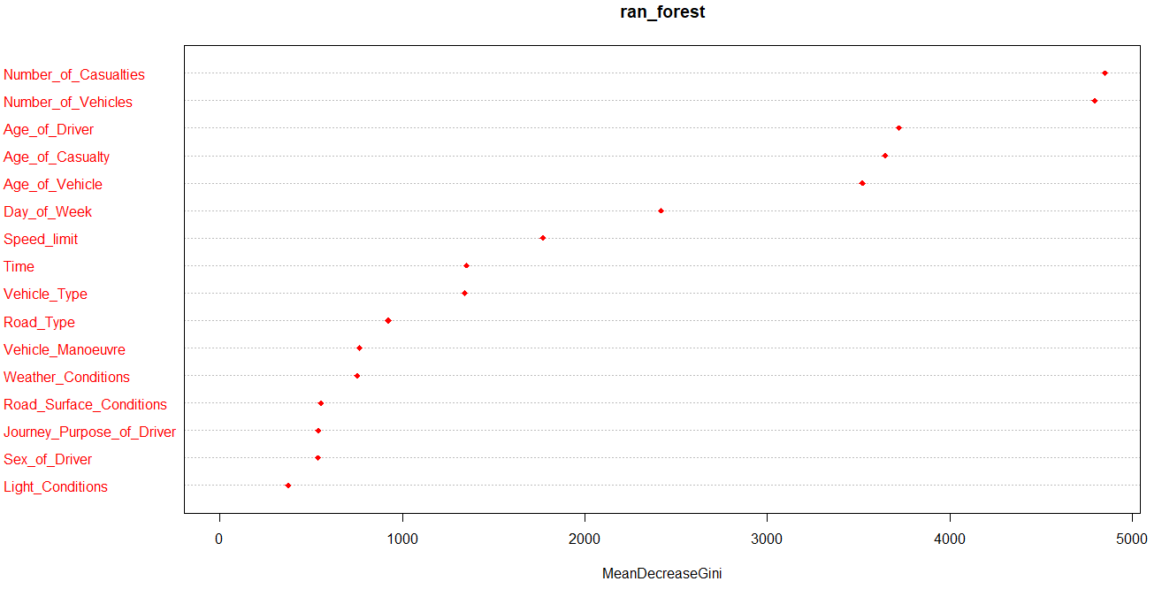
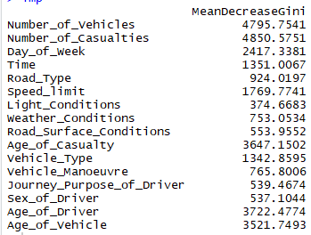
Data Modelling – Random Forest (cont’d.)
Identifying the significant variables from random forest model:

Slide 40
Data Modelling – Random Forest (cont’d.)
Implementation, evaluation, and results of the second random forest model with only the identified significant variables as input:
Accuracy of the revised random forest model: 73.73% (2% decrease)
Accuracy of the revised decision tree model: 64.4% (Same as existing)
Accuracy of the revised logistic regression model: 65.33% (0.3% decrease)
Accuracy of the revised Naïve Bayes model: 65.98% (0.02% increase)
Based on the above results, it has been noticed that the insignificant variables didn’t really affect the performance of the existing models as they neither affected the accuracy of the revised models in a positive or negative way, thereby not contributing much to the prediction of the dependent variable.

Slide 41
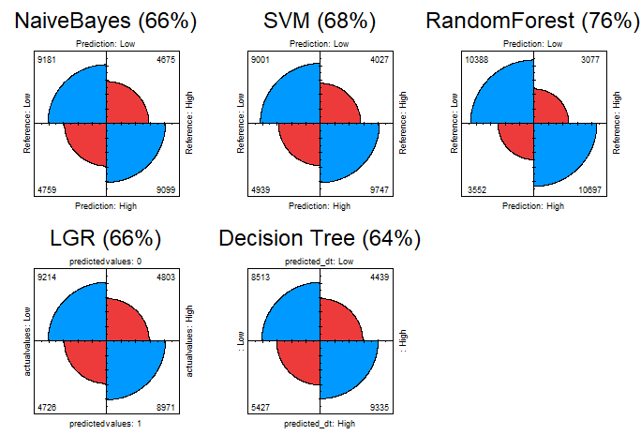
Data Evaluation
Evaluation based on the accuracy of each model:

Slide 42
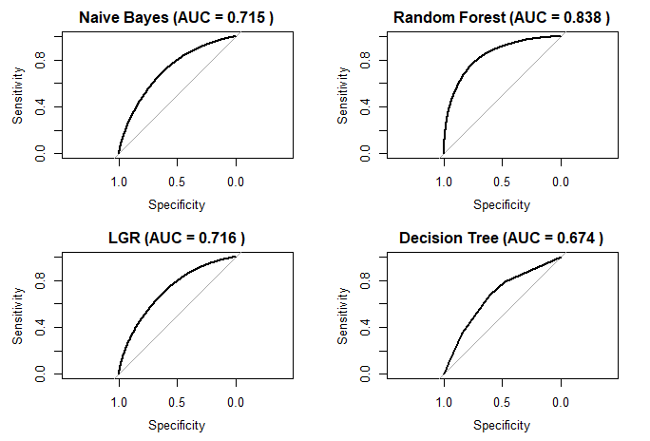
Data Evaluation (cont’d)
Evaluation based on the ROC curve of each model:

Slide 43
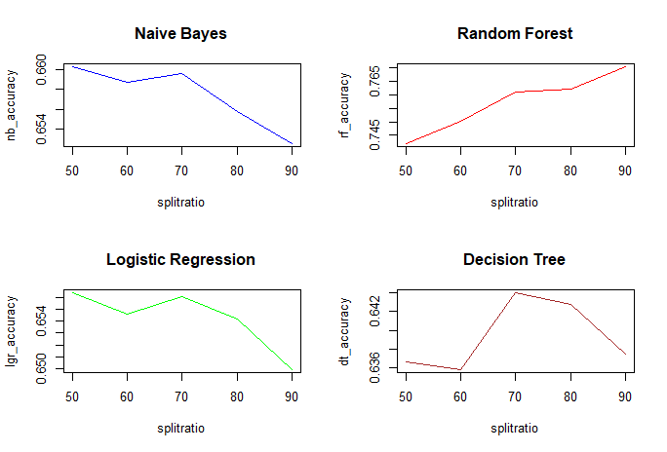
Data Evaluation (cont’d)
Comparison of the performance of models under various split ratios:

Slide 44
Data evaluation - Summary:
Comparison of the performance of models under various split ratios:
Model | Accuracy (%) | Precision (%) | Recall (%) | AUC
Naïve Bayes | 65.96 | 66 | 66 | 0.715
Support Vector Machines | 67.65 | 69 | 65 | -
Random Forest | 76.08 | 77 | 75 | 0.838
Logistic Regression | 65.61 | 65 | 66 | 0.716
Decision Tree | 64.40 | 66 | 61 | 0.674

Slide 45
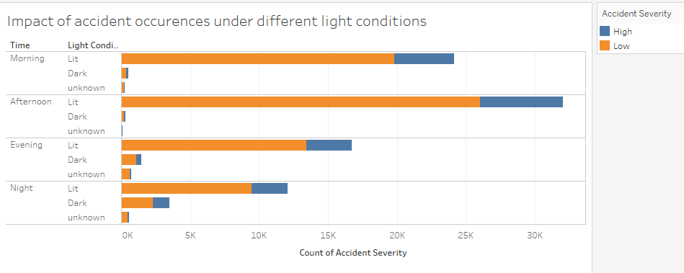
Data Visualization:
Case 1: Effects of time of the day and light conditions on the accident severity.

Slide 46
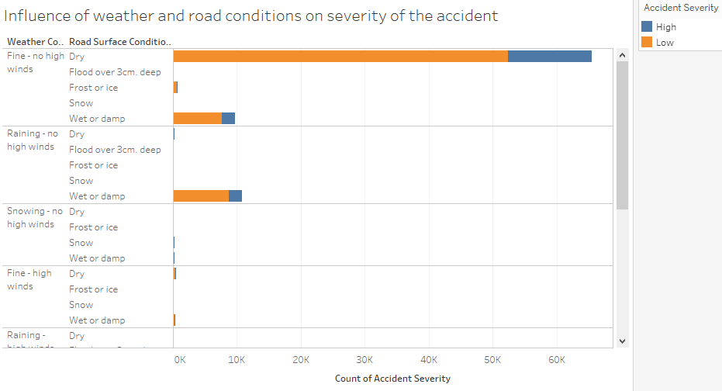
Data Visualization (cont’d.)
Case 2: Influence of weather and road conditions on severity of the accident

Slide 47
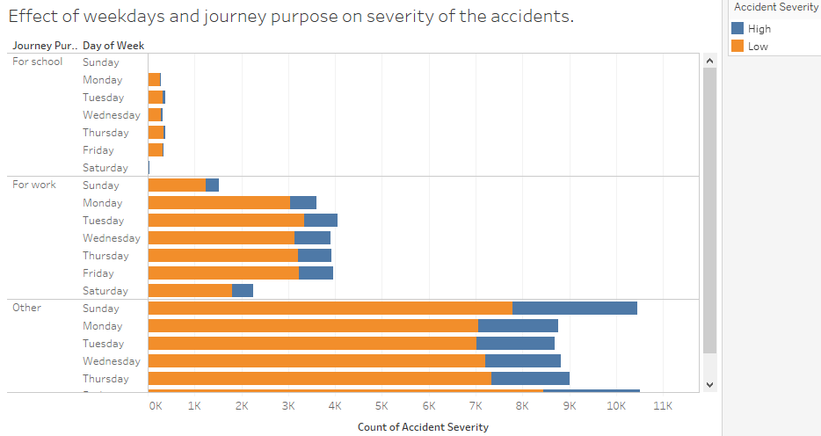
Data Visualization (cont’d.)
Case 3: Effect of weekdays and journey purpose on severity of the accidents

Slide 48
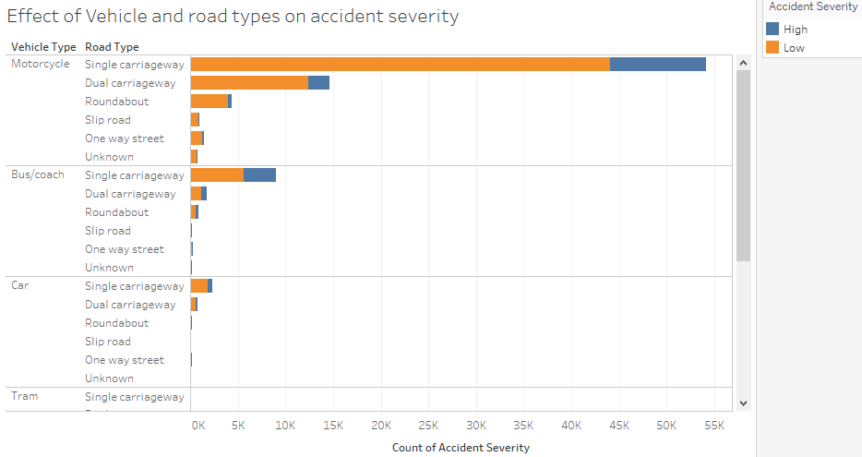
Data Visualization (cont’d.)
Case 4: Effect of Vehicle and road types on accident severity

Slide 49
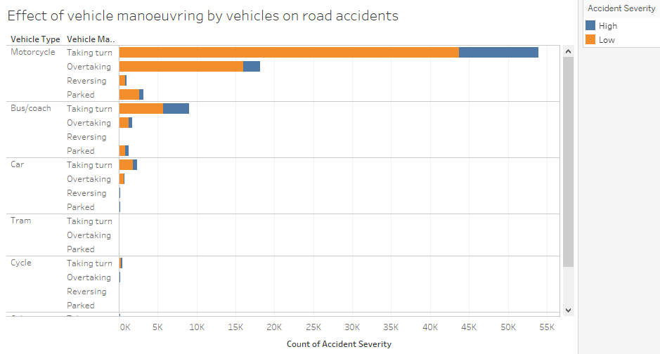
Data Visualization (cont’d.)
Case 5: Effect of vehicle maneuvering by vehicles on road accidents

Slide 50
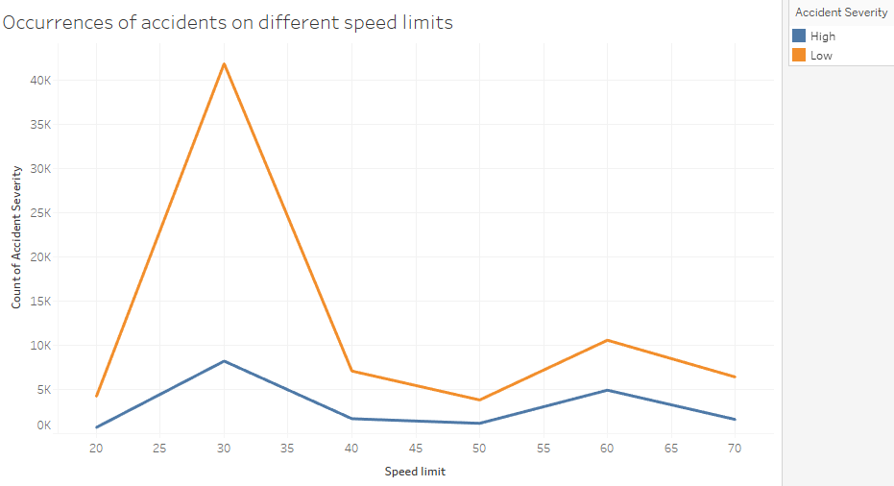
Data Visualization (cont’d.)
Case 6: Occurrences of accidents on different speed limits

Slide 51
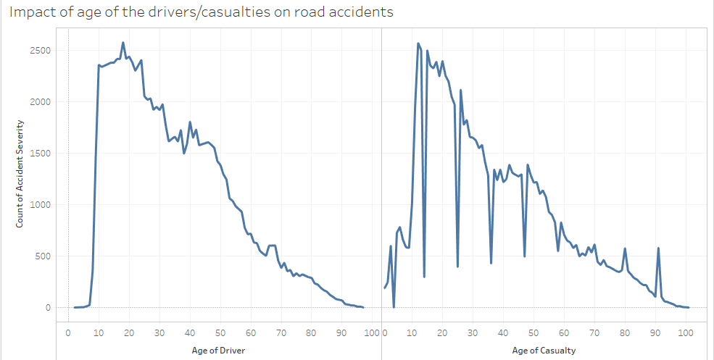
Data Visualization (cont’d.)
Case 7: Impact of age of the drivers/casualties on road accidents

Slide 52
Contents
1
Research Problem
2
Introduction
3
Literature review
4
Methodology
5
Implementation
6
Conclusion
7
References

Slide 53
Conclusion & Future work
The aim and objective of this research project was to predict the severity of the road traffic accidents in Great Britain. Several data mining techniques were handled and experimented to tackle the problem of determining the accident severity in Great Britain. It was observed that most of the accidents had occurred during the daytime or well-lit conditions on dry/wet roads when the weather was totally fine with no high winds. It was also observed that vehicles that accounted for most of the accidents were motorcycles and people who accounted for most of these accidents were office goers. Several classification models were built to make effective prediction of the target variable. It was observed that the Random Forest technique performed the best among all the other models with 76 % accuracy.
The candidate proposes a future work to determine the accidents hotpots and find out the severity of those hotspots which in turn could help the concerned officials in increasing the safety measures to reduce the accident occurrences in such areas. In addition, the candidate also proposes to experiment the implementation of more data mining techniques to improve the prediction accuracy of the road traffic accidents, which were not carried out in this study due to the limited time frame

Slide 54
Contents
1
Research Problem
2
Introduction
3
Literature review
4
Methodology
5
Implementation
6
Conclusion
7
References

Slide 55
References
Achmad, H., Sabur, V. F., Pritasari, A. & Reinaldo, H., 2016. Data mining and sharing to create usable knowledge, implementation in small business in Indonesia. Sains Humanika, Volume 8, pp. 1-2.
Ahlawat, A. & Suri, B., 2016. Improving classification in data mining using hybrid algorithm. Information Processing (IICIP), 2016 1st India International Conference on IEEE, pp. 1-4.
Anderson, T. K., 2009. Kernel density estimation and k-means clustering to profile road accident hotspots. Accident Analysis & Prevention, 41(3), pp. 359-364.
Atnafu, B. & Kaur, G., 2017. Survey on analysis and prediction of road traffic accident severity levels using data mining techniques in Maharashtra, India. International Journal of Current Engineering and Technology, 7(6), pp. 1973-1978.
Beshah, T. & Hill, S., 2010. Mining road traffic accident data to improve safety: Role of road-related factors on accident severity in ethiopia. AAAI Spring Symposium: Artificial Intelligence for Development..
Chong, M., Abraham, A. & Paprzycki, M., 2005. Traffic accident analysis using machine learning paradigms. Informatica, 29(1).
data.gov.uk, 2018. Road Safety Data. [Online]
Available at: https://data.gov.uk/dataset/053a6529-6c8c-42ac-ae1e-455b2708e535/road-traffic-accidents
Datla, M. V., 2015. Bench marking of classification algorithms: Decision trees and random forests - a case study using r. Trends in Automation, Communications and Computing Technology (I-TACT-15), 2015 International Conference on, IEEE, pp. 1-7.
Esmaeili, A., Khalili, M. & Pakgohar, A., 2012. Determining the road defects impact on accident severity; based on vehicle situation after accident, an approach of logistic regression. Statistics in Science, Business, and Engineering (ICSSBE), 2012 International Conference on, IEEE, pp. 1-4.
Ghomi, H., Fu, L., Bagheri, M. & Miranda-Moreno, L. F., 2017. Identifying vehicle driver injury severity factors at highway-railway grade crossings using data mining algorithms. Transportation Information and Safety (ICTIS), 2017 4th International Conference on, IEEE, pp. 1054-1059.
Gopalakrishnan, S., 2012. A Public Health Perspective of Road Traffic Accidents. Journal of family medicine and primary care, 1(2), p. 144.
Huang, K., 2017. Field Support Vector Machines. IEEE Transactions on Emerging Topics in Computational Intelligence ( Volume: 1 , Issue: 6 ), pp. 454-463.
Jackson, L. & Cracknell, R., 2018. Road accident casualties in Britain and the world. House of Commons Library, p. 6.
Kabeer, S. I., 2016. Analysis of road accident in leeds. p. 12.

Slide 56
References
Kashani, A. T. & Mohaymany, A. S., 2011. Safety Science, 49(10), pp. 1314-1320.
Li, L., Shrestha, S. & Hu, G., 2017. Analysis of road traffic fatal accidents using data mining techniques. Software Engineering Research, Management and Applications (SERA), 2017 IEEE 15th International Conference on, IEEE, pp. 363-370.
Mahajan, N. & Kaur, B. P., 2016. International Journal of Computer Applications (0975-8887) volume.
Patel, K., 2010. Lowering the barrier to applying machine learning. Adjunct proceedings of the 23nd annual ACM symposium on User interface software and technology, ACM, pp. 355-358.
Patel, P. & Mistry, K., 2015. A review: Text classification on social media data. IOSR Journal of Computer Engineering, 17(1), pp. 80-84.
Priyanka, A. & Sathiyakumari, K., 2014. A comparative study of classiffication algorithm using accident data. International Journal of Computer Science & Engineering Technology (IJCSET), 5(10), pp. 1018-1023.
Quddus, M. A., Wang, C. & Ison, S. G., 2009. Road traffic congestion and crash severity: econometric analysis using ordered response models. Journal of Transportation Engineering, 136(5), pp. 424-435.
Shanthi, S. & Ramani, R. G., 2012. Feature relevance analysis and classification of road traffic accident data through data mining techniques. Proceedings of the World Congress on Engineering and Computer Science, Volume 1, pp. 24-26.
Tavakoli Kashani, A., Shariat-Mohaymany, A. & Ranjbari, A., 2011. A data mining approach to identify key factors of traffic injury severity. PROMET - Traffic & Transportation, 23(1), pp. 11-17.
Tesema, T. B., Abraham, A. & Grosan, C., 2005. Rule mining and classification of road traffic accidents using adaptive regression trees. International Journal of Simulation , 6(10), pp. 80-94.
Theofilatos, A., Graham, D. & Yannis, G., 2012. Factors affecting accident severity inside and outside urban areas in greece. Traffic injury prevention, 13(5), pp. 458-467.
Tian, R., Yang, Z. & Zhang, M., 2010. Method of road traffic accidents causes analysis based on data mining. Computational Intelligence and Software Engineering (CiSE), 2010 International Conference on, IEEE, pp. 1-4.
Vorko-Jovic, A., Kern, J. & Biloglav, Z., 2006. Risk factors in urban road traffic accidents. Journal of Safety Research, 37(1), pp. 93-98.

Slide 57
References
Yannis, G., Golias, J. & Papadimitriou, E., 2005. Driver age and vehicle engine size effects on fault and severity in young motorcyclists accidents. Accident Analysis & Prevention, 37(2), pp. 327-333.
Zekić-Sušac, M., Šarlija, N., Has, A. & Bilandžić, A., 2016. Predicting company growth using logistic regression and neural networks. Croatian Operational Research Review, p. 236.
Zhang, G., Yau, K. K. & Chen, G., 2013. Risk factors associated with traffic violations and accident severity in china. Accident Analysis & Prevention, Volume 59, pp. 18-25.
Zong, F., Xu, H. & Zhang, H., 2013. Prediction for traffic accident severity: comparing the bayesian network and regression models. Mathematical Problems in Engineering

Slide 58


